Slide 1
Study AId : A Secure E-Commerce Website
CSCE 4560 - Group 9:
Ben Murley, Bhargav Reddy, Edward Tomlinson

Slide 2

Introductions
Design Overview
What problem are we addressing?

Slide 3
Design Overview
Base - Wordpress
Plugins
Content
WooCommerce/Woopayments
Security
Wordfence
Loginizer

Slide 4
What problem are we addressing?
Increase in student reliance on AI for answers
Instead of leveraging AI for answers, leverage it for more constructive study help!

Slide 5
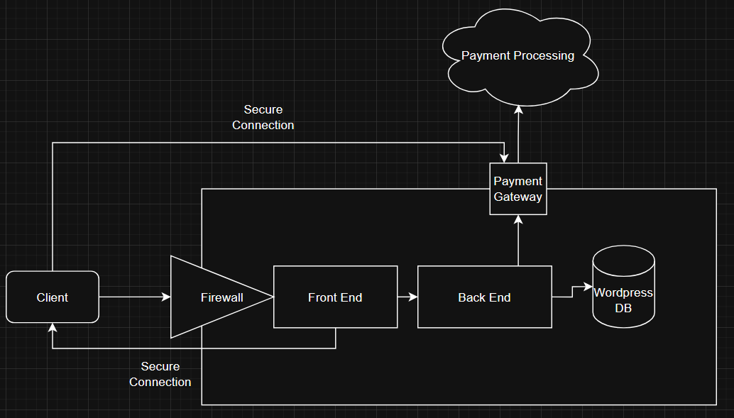
Project Structure Design
Client-Server Structure

Slide 6
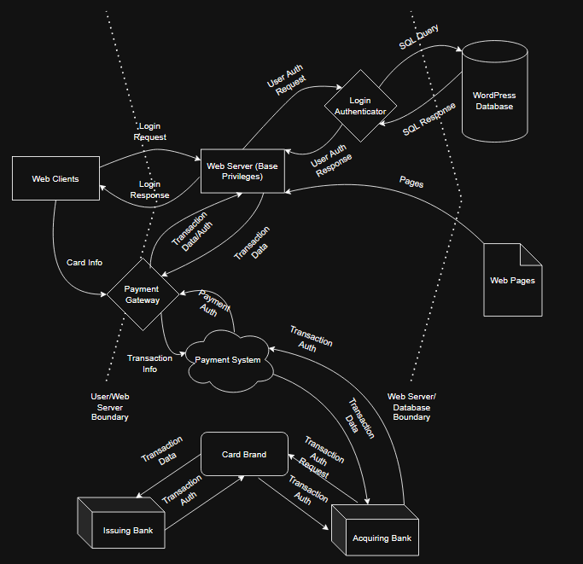
Project Structure Design
Data Flow Diagram

Slide 7
Results and Analysis
Successfully designed/deployed E-Commerce website
User creation with optional 2FA
Checkout with secure payment
Performed security testing on website; assessed and resolved major issues
Nessus
Zed Attack Proxy (ZAP)

Slide 8
Nessus Scan Analysis
Main Issue: HSTS Missing From HTTPS Server (RFC 6797)
Enforces HTTPS-only connection
Other Vulnerabilities Flagged:
SMTP Server Non-standard Port
ICMP Timestamp Request Remote Date Disclosure

Slide 9
Zap Scan Analysis
Content Security Policy Not Set (XSS)
CSP restricts scripts and images by source
Other Vulnerabilities Flagged:
Missing Anti-clickjacking header

Slide 10
Project Timeline
Planning
Design
Development
Testing

Slide 11
Accomplishments+Takeaways
Deployment of functional, secure website
Used knowledge from class and outside resources
Vulnerability Testing and Analysis
Used multiple approved vulnerability testing tools
Addressed major issues

Slide 12
References+Resources
Tenable (https://www.tenable.com/plugins)
CWE (https://cwe.mitre.org/)
WordPress Documentation (https://wordpress.org/documentation/)

